Slide 1

Hearing Sound
The Special Relationship Between Us and Sound

Slide 2


Sound: What We Know
Recall:
We know sound is a mechanical wave. It requires a medium in order to transfer energy from one location to another. More specifically, it is a longitudinal wave.
...What else do we know?
Notes:
We can calculate speeds, use this information to determine distances to/from objects, relate frequency to pitch and amplitude to loudness (and variations in these from the Doppler effect), we can use the principle of superposition to explain variations in loudness (including beats). We can use waves (and their reflections) to explain how instruments using strings, open air columns and closed air columns work. We even know that when a wave loses energy it is undergoing damping (which may be positive or negative) and that the process of resonance can be used to periodically but continually add energy to a system which may result it catastrophic results.

Slide 3
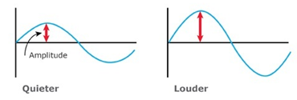
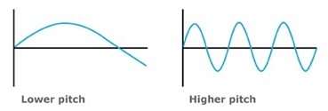
Our Perception of Sound
Recall:
The amplitude of the pressure of the sound relates to its loudness.
The frequency of the sound relates to its pitch.

Slide 4
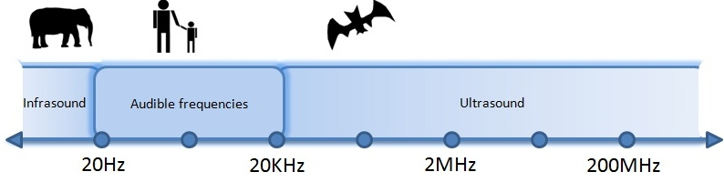
Types of Sound Waves
Recall:
There are three types of sound waves:
Infrasonic (f<20 Hz)
Audible (20 Hz < f < 20 kHz)
Ultrasonic (f > 20 kHz)
Notes:
Different lifeforms are able to hear different frequencies. Different ages are also able to hear different frequencies.

Slide 5
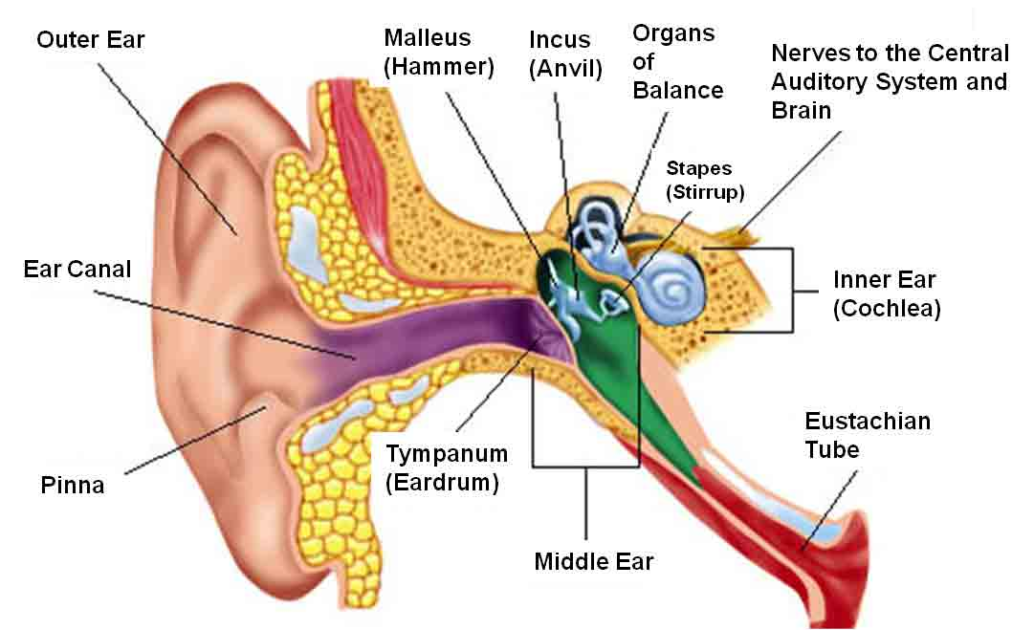
How Our Ear Works
Our eardrums are responsible for perceiving sounds.
Notes:
*it measures the pressure changes your ear receives each second per unit area
https://www.youtube.com/watch?v=r-c5GpoD8wI

Slide 6

Practicing Safe Sound
However, our ears are sensitive and cannot handle very intense sound.
Where sound intensity specifically refers to the power of sound per unit area [W/m²]
Notes:
*it measures the pressure changes your ear receives each second per unit area

Slide 7
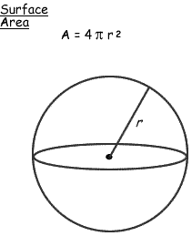
Quantifying Sound Intensity
Measured in
Notes:
Intensity = Energy / time / (4*pi*r^2)
Pressure = force / area
Loudness depends on distance to source

Slide 8

Example
A helicopter hovers overhead during an airshow, causing sound waves to emanate uniformly. If the first listener is 7.0x10² m away and the second listener is 1.0x10³ m away, by how much has the intensity level of the sound decreased when it reaches the second listener?
Notes:
Ans; the intensity level is 0.49 of what it was by the time it reaches listener 2.

Slide 9
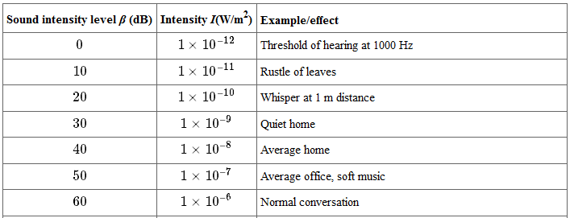
What observations can you make from the following table?
Notes:
Table 1 from: http://cnx.org/content/m42257/latest/?collection=col11406/latest
Here’s what we can see: 0 dB = 1x10-12 W/m2 (threshold of hearing)
A change in 100 W/m2 = a change in 10 dB
The bel scale is logarithmic (but we will not be doing calculations with this). If you’re curious, here’s how it works:
Intensity (B) = log_10 (I2/I1) where both I2 and I1 are measured in W/m2 ... To determine the intensity in decibels we would multiply the number of bels by 10.

Slide 10
Human Perception of Sound Intensity
The threshold of hearing is very large. To make it more convenient, we use a unit called the decibel (dB). When using decibels, we refer to sound level instead of sound intensity.
See Table 2: Typical Sound Levels on page 395

Slide 11
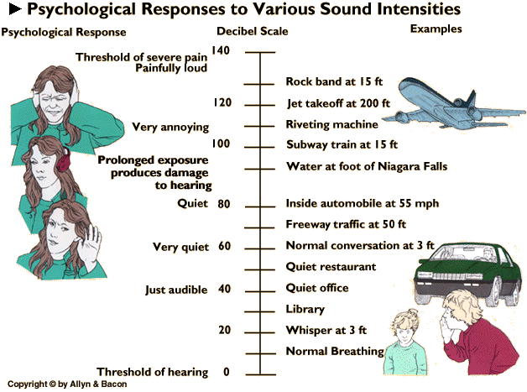
Practicing Safe Sound
Notes:
What can we do? Avoid prolonged exposure and wear earplugs if prolonged exposure would cause problems

Slide 12
Units of Sound Intensity
Sound intensity may be measured in:
- - bels (B) - decibels (dB)
Where: I is the sound intensity [W/m²]
β is the intensity equivalent to I₂ [dB]
Notes:
In general, the sound intensity must be increased by a factor of 10 in order for the loudness (ear’s perception of sound) to double
Where 10 dB = 10x10⁻¹ B = 1 B

Slide 13

Example
A typical alarm clock will have a sound intensity of 1.0x10⁻⁶ W/m² at a distance of 1.0 m. Determine the equivalent intensity, in dB.
Notes:
Ans: 60 dB

Slide 14

Example
A typical motorcycle has a sound intensity of 90 dB. Determine the equivalent intensity, in W/m².
Notes:
Ans: 1x10⁻³ W/m²

